Slide 1
Quaking aspen microbiome tutorial in QIIME2
Jake Nash
Bio 557
February 20, 2024

Slide 2
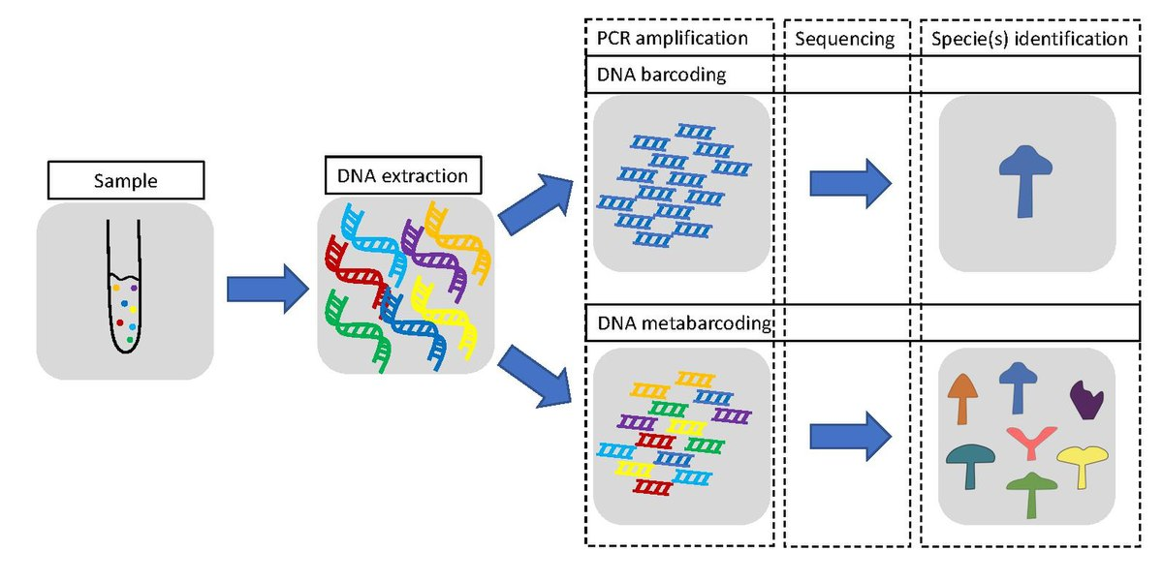
Metbarcoding tells us who is there and in what abundance
Used for mixed samples (stool, plant, soil) containing 100s-1000s of species
David Casmor, Wikipedia

Slide 3
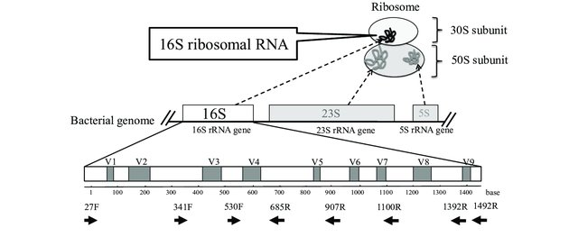
16S (ribosomal small subunit) commonly used as a bacterial/archaeal gene marker
Image from: Fukuda K, Ogawa M, Taniguchi H, Saito M. doi: 10.7888/juoeh.38.223. PMID: 27627970.

Slide 4


Slide 5
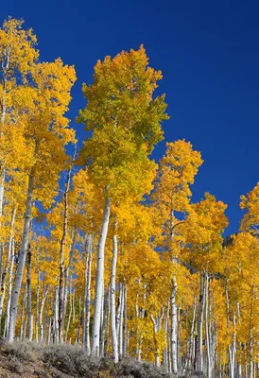
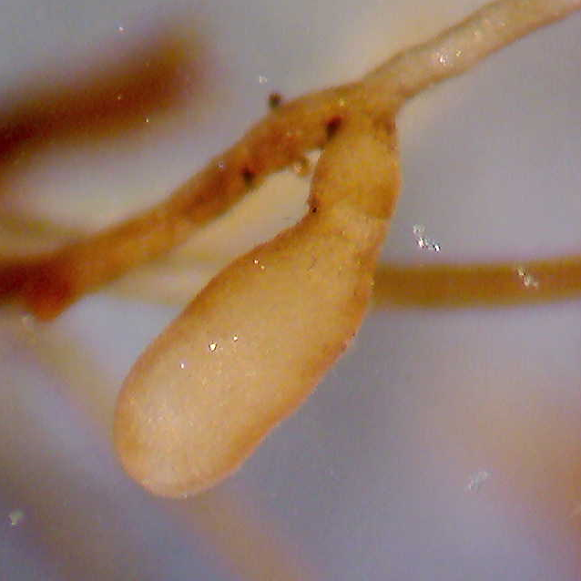
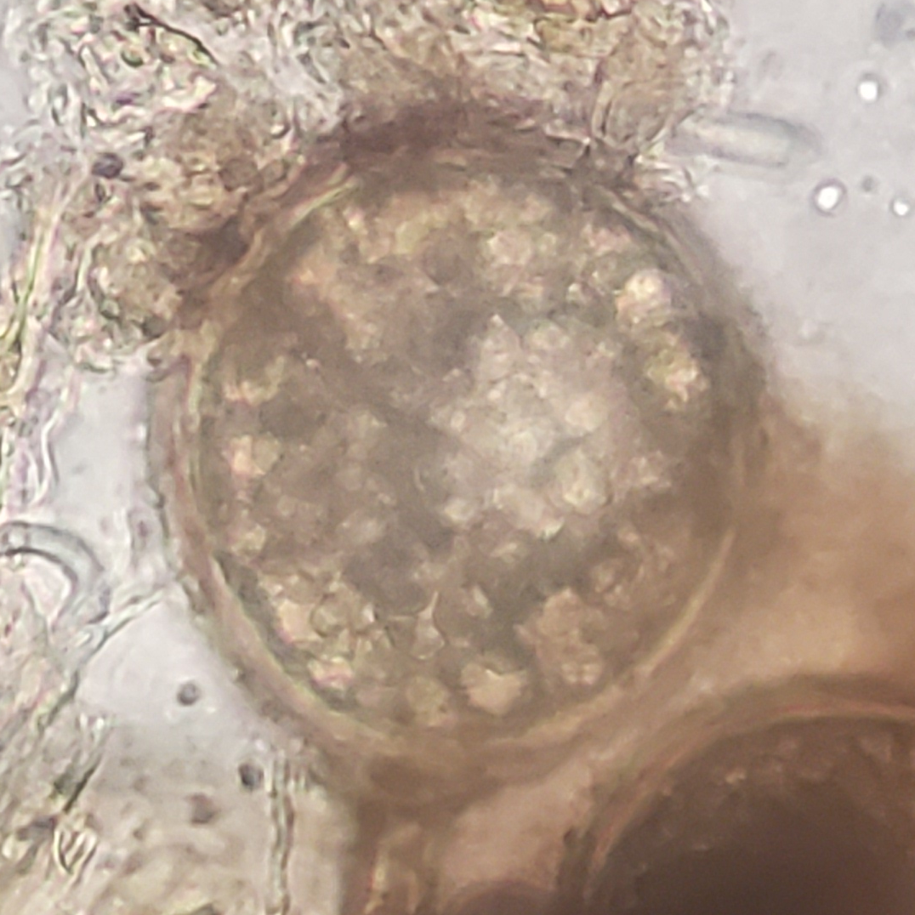
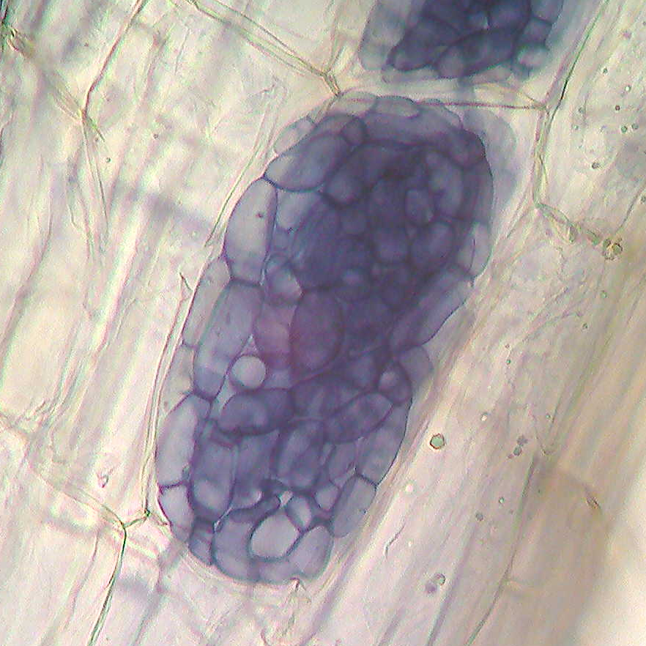
Populus tremuloides
Quaking aspen
Populus tremuloides
Model woody plant
Use in biofuel cropping
Ecological dominant
Under threat from climate change + pests
Arbuscular Mycorrhizae
Dark Septate Endophytes
Ectomycorrhizae
Notes:
Modify to tie into conclusions

Slide 6
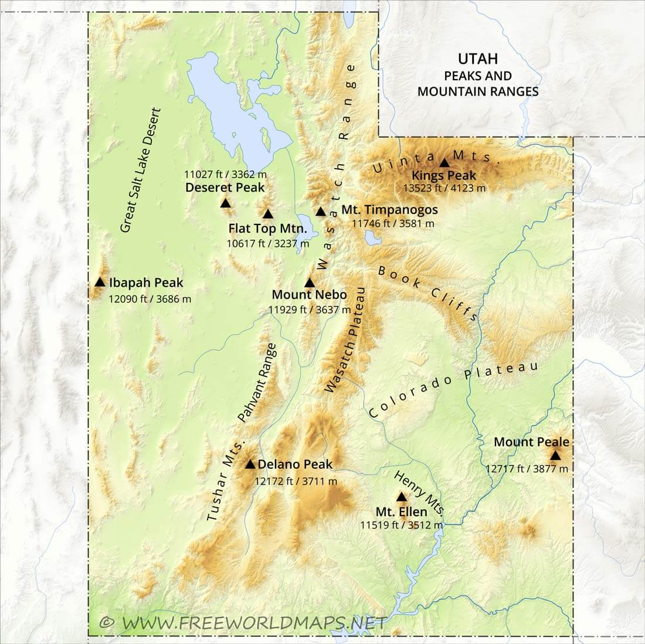
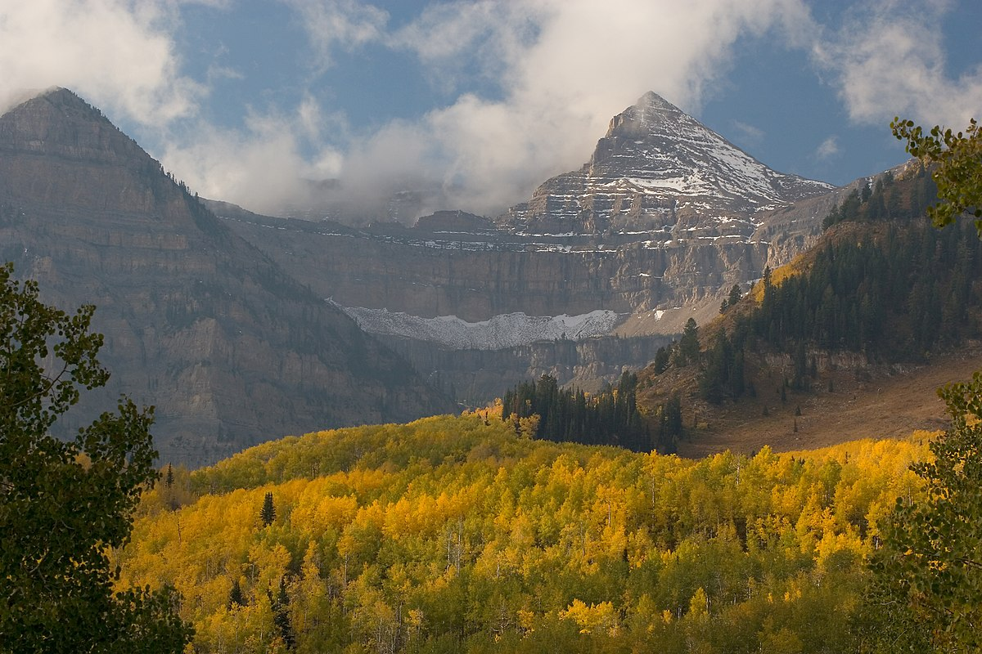
The Uinta Mountains
An east-west range in northern Utah with stark relief and intense seasonal drought
Image from Wikipedia

Slide 7
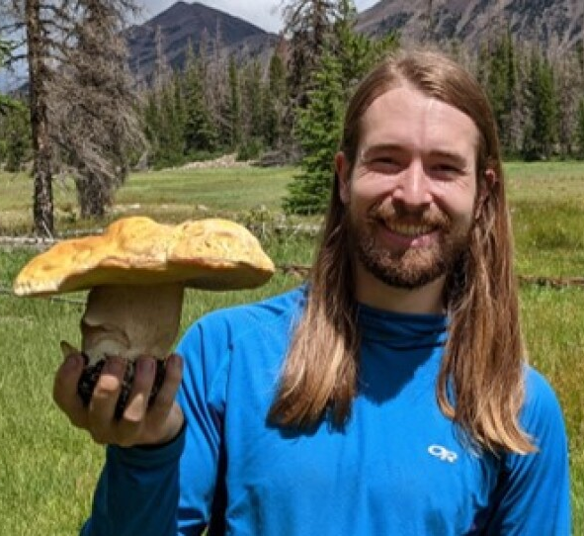
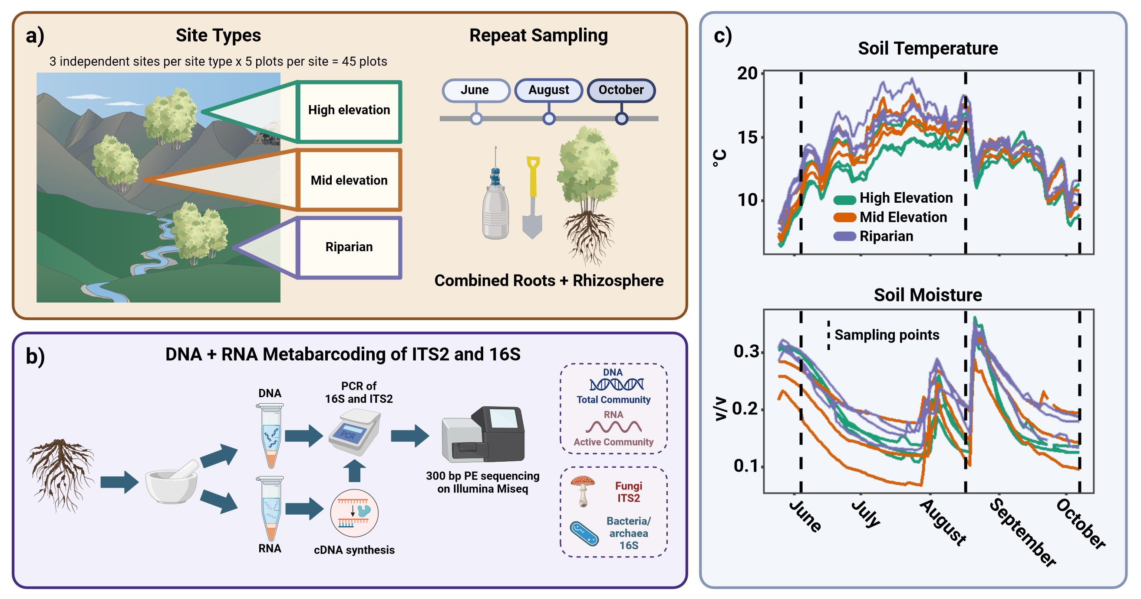
Profiling the quaking aspen microbiome across an environmental gradient

Slide 8
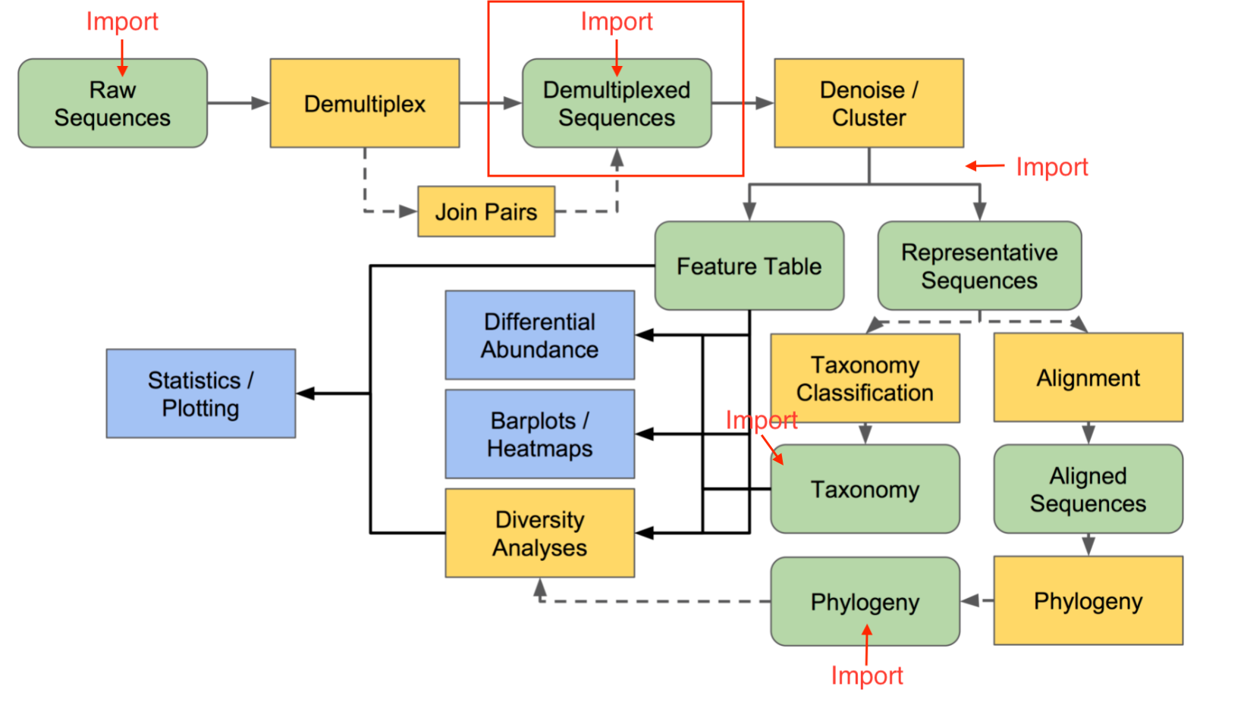
QIIME2 Pipeline
Image adapted from QIIME2 documentation

